Slide 1

CPE 490 Embedded Systems Lecture 22
dsPIC33F256GP710A DMA system
See section 22 of the family reference manual on Blackboard

Slide 2
Direct Memory Access
Buffering
Temporarily storing data in memory before processing
Data accumulated in peripherals commonly buffered
Microprocessor could handle this with ISR
Storing and restoring microprocessor state inefficient
Regular program must wait
DMA controller more efficient
Separate single-purpose processor or built in pheripheral
Microprocessor relinquishes control of system bus to DMA controller
Microprocessor can meanwhile execute its regular program
No inefficient storing and restoring state due to ISR call
Regular program need not wait unless it requires the system bus
Harvard archictecture – processor can fetch and execute instructions as long as they don’t access data memory – if they do, processor stalls

Slide 3
Peripheral to memory transfer without DMA, using vectored interrupt
Time
1(a): μP is executing its main program.
1(b): P1 receives input data in a register with address 0x8000.
2: P1 asserts Int to request servicing by the microprocessor.
3: After completing instruction at 100, μP sees Int asserted, saves the PC’s value of 100, and asserts Inta.
4: P1 detects Inta and puts interrupt address vector 16 on the data bus.
5(a): μP jumps to the address on the bus (16). The ISR there reads data from 0x8000 and then writes it to 0x0001, which is in memory.
5(b): After being read, P1 deasserts Int.
6: The ISR returns, thus restoring PC to 100+1=101, where μP resumes executing.

Slide 4
Peripheral to memory transfer without DMA, using vectored interrupt
1(a): μP is executing its main program
1(b): P1 receives input data in a register with address 0x8000.
Program memory
μP
Data memory
ISR
0x0000
0x0001
16:
MOV R0, 0x8000
17:
# modifies R0
18:
MOV 0x0001, R0
System bus
19:
RETI # ISR return
...
Main program
Inta
P1
...
Int
100:
instruction
16
101:
instruction
PC
0x8000

Slide 5
Peripheral to memory transfer without DMA, using vectored interrupt
2: P1 asserts Int to request servicing by the microprocessor
Program memory
μP
Data memory
ISR
0x0000
0x0001
16:
MOV R0, 0x8000
17:
# modifies R0
18:
MOV 0x0001, R0
System bus
19:
RETI # ISR return
...
Main program
Inta
P1
...
Int
100:
Int
16
instruction
101:
instruction
PC
1
0x8000
100

Slide 6
Peripheral to memory transfer without DMA, using vectored interrupt
3: After completing instruction at 100, μP sees Int asserted, saves the PC’s value of 100, and asserts Inta.
Program memory
μP
Data memory
ISR
0x0000
0x0001
16:
MOV R0, 0x8000
17:
# modifies R0
18:
MOV 0x0001, R0
System bus
19:
RETI # ISR return
...
1
Inta
Main program
Inta
P1
...
Int
100:
instruction
16
101:
instruction
PC
0x8000
100
100

Slide 7
Peripheral to memory transfer without DMA, using vectored interrupt (cont’)
4: P1 detects Inta and puts interrupt address vector 16 on the data bus.
Program memory
μP
Data memory
ISR
0x0000
0x0001
16:
MOV R0, 0x8000
17:
# modifies R0
System bus
18:
MOV 0x0001, R0
16
System bus
19:
RETI # ISR return
...
Main program
Inta
P1
...
Int
16
100:
instruction
16
101:
instruction
PC
0x8000
100

Slide 8
Peripheral to memory transfer without DMA, using vectored interrupt (cont’)
5(a): μP jumps to the address on the bus (16). The ISR there reads data from 0x8000 and then writes it to 0x0001, which is in memory.
5(b): After being read, P1 de-asserts Int.
μP
Data memory
Program memory
Data memory
0x0000
0x0001
ISR
0x0001
ISR
ISR
16:
16:
16:
MOV R0, 0x8000
MOV R0, 0x8000
MOV R0, 0x8000
17:
# modifies R0
17:
17:
# modifies R0
# modifies R0
System bus
18:
MOV 0x0001, R0
System bus
18:
18:
MOV 0x8001, R0
19:
19:
19:
RETI # ISR return
RETI # ISR return
RETI # ISR return
...
...
...
Main program
Inta
Main program
Main program
P1
P1
...
...
...
Int
Int
16
100:
100:
100:
instruction
instruction
instruction
PC
0
101:
instruction
101:
101:
instruction
instruction
0x8000
0x8000
100

Slide 9
Peripheral to memory transfer without DMA, using vectored interrupt (cont’)
6: The ISR returns, thus restoring PC to 100+1=101, where μP resumes executing.
Program memory
μP
Data memory
ISR
0x0000
0x0001
ISR
16:
MOV R0, 0x8000
16:
MOV R0, 0x8000
17:
# modifies R0
17:
# modifies R0
18:
System bus
18:
MOV 0x8001, R0
MOV 0x0001, R0
19:
19:
RETI # ISR return
RETI # ISR return
...
...
Main program
Inta
Main program
P1
...
...
Int
100:
16
100:
instruction
instruction
101:
PC
101:
instruction
instruction
0x8000
+1
100
100

Slide 10
Peripheral to memory transfer with DMA
1(a): μP is executing its main program. It has already configured the DMA ctrl registers.
1(b): P1 receives input data in a register with address 0x8000.
Time
3: DMA ctrl asserts Dreq to request control of system bus.
4: After executing instruction 100, μP sees Dreq asserted, releases the system bus, asserts Dack, and resumes execution. μP stalls only if it needs the system bus to continue executing.
2: P1 asserts req to request servicing by DMA ctrl.
5: (a) DMA ctrl asserts ack (b) reads data from 0x8000 and (b) writes that data to 0x0001.
6:. DMA de-asserts Dreq and ack completing handshake with P1.
7(a): μP de-asserts Dack and resumes control of the bus.
7(b): P1 de-asserts req.

Slide 11
Peripheral to memory transfer with DMA (cont’)
1(a): μP is executing its main program. It has already configured the DMA ctrl registers
1(b): P1 receives input data in a register with address 0x8000.
Program memory
μP
Data memory
0x0000
0x0001
No ISR needed!
System bus
...
Dack
Main program
DMA ctrl
P1
...
Dreq
ack
0x0001
100:
instruction
PC
req
101:
instruction
0x8000
0x8000
100

Slide 12
Peripheral to memory transfer with DMA (cont’)
2: P1 asserts req to request servicing
by DMA ctrl.
3: DMA ctrl asserts Dreq to request control of system bus
Program memory
μP
Data memory
0x0000
0x0001
No ISR needed!
System bus
...
Dack
DMA ctrl
P1
DMA ctrl
P1
Main program
P1
Dreq
...
Dreq
1
0x0001
ack
100:
instruction
PC
req
0x8000
req
101:
instruction
1
0x8000
100

Slide 13
Peripheral to memory transfer with DMA (cont’)
4: After executing instruction 100, μP sees Dreq asserted, releases the system bus, asserts Dack, and resumes execution, μP stalls only if it needs the system bus to continue executing.
Program memory
μP
Data memory
0x0000
0x0001
No ISR needed!
System bus
...
1
Dack
Dack
DMA ctrl
P1
Main program
Dreq
...
0x0001
ack
100:
instruction
PC
req
101:
instruction
0x8000
0x8000
100

Slide 14
Peripheral to memory transfer with DMA (cont’)
5: DMA ctrl (a) asserts ack, (b) reads data from 0x8000, and (c) writes that data to 0x0001.
(Meanwhile, processor still executing if not stalled!)
μP
Data memory
Program memory
Data memory
0x0000
0x0001
0x0000
0x0001
No ISR needed!
System bus
System bus
...
Dack
DMA ctrl
P1
Main program
DMA ctrl
P1
...
Dreq
1
ack
ack
0x0001
ack
0x0001
100:
instruction
PC
req
0x8000
req
0x8000
0x8000
101:
instruction
0x8000
100

Slide 15
Peripheral to memory transfer with DMA (cont’)
6: DMA de-asserts Dreq and ack completing the handshake with P1.
Program memory
μP
Data memory
0x0000
0x0001
No ISR needed!
System bus
...
Dack
Main program
DMA ctrl
P1
Dreq
0
...
Dreq
ack
0
0x0001
ack
100:
instruction
PC
req
101:
instruction
0x8000
0x8000
100

Slide 16
Peripheral to memory transfer with DMA (cont’)
7(a): uP deasserts DACK and resumes control of the bus
7(b): peripheral P1 deasserts req
Program memory
μP
Data memory
0x0000
0x0001
No ISR needed!
System bus
...
Dack
Main program
DMA ctrl
P1
Dreq
0
...
Dreq
ack
0
0x0001
ack
100:
instruction
PC
req
101:
instruction
0x8000
0x8000
100

Slide 17
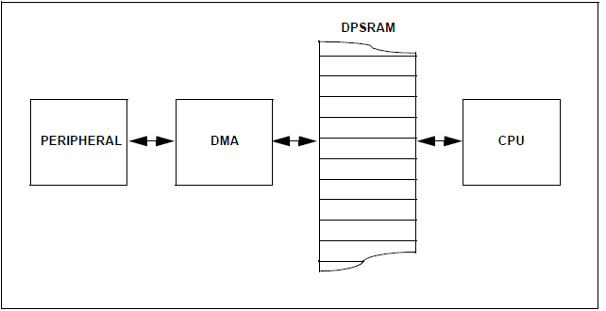
dsPIC33 DMA Structure
Dual Port Static Random Access Memory – prevents bus contention between CPU and DMA peripheral. No cycle stealing needed.
Notes:
The only situation dual port RAM can not handle is when both DMA controller and CPU try to write to the same address. If this occurs a trap is executed, so recovery can be implemented.

Slide 18
DMA is Bi-Directional
The DMA can write data to the peripheral (like DAC) or it can read from the peripheral (like ADC)

Slide 19
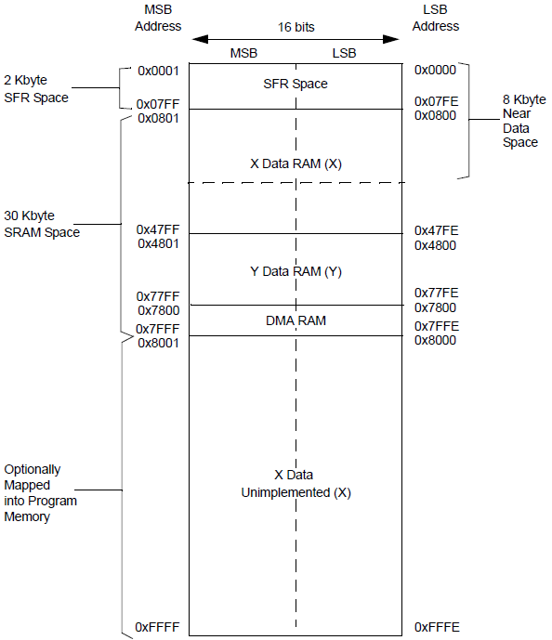
Dual port RAM is mapped into the Data memory space 2K bytes of space available
Notes:
Dual port ram starts at 0x7800 and ends at 0x7FEE

Slide 20
DMA Multiple Channels
The DMA has 8 channels in it, all can be accessing peripherals.
Writing to DPSRAM is prioritized base on the channel number.
If a peripheral needs data and writes data two channels must be used.
Notes:
I a peripheral both reads and writes then it will consume two DMA channels

Slide 21
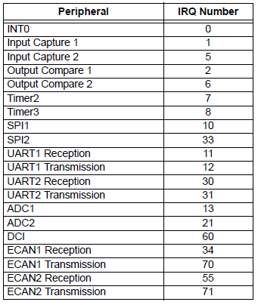
Peripherals with DMA Support

Slide 22
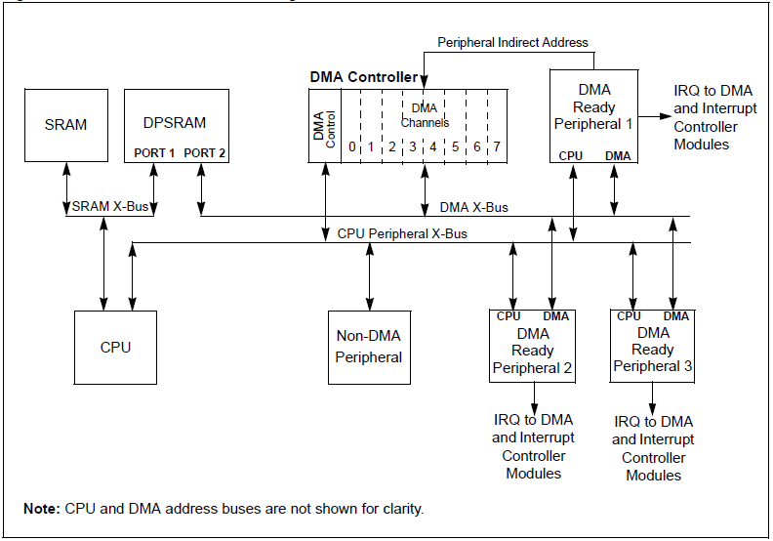
dsPIC33 DMA Block Diagram
Interrupt is DMA Request
One transfer per inst. cycle
Normal Address
Notes:
Make sure to NOT enable the interrupt that will be used to alert the DMA controller to action.

Slide 23
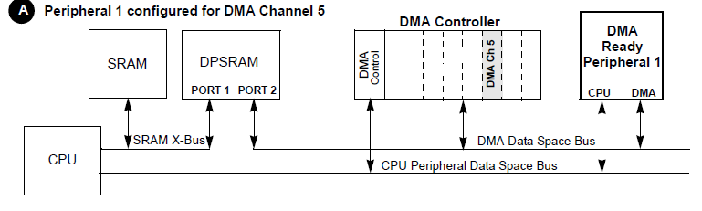
DMA EXAMPLE
In this example, DMA Channel 5 is configured to operate with DMA-Ready Peripheral 1.
Notes:
Link is made between peripheral and DMA channel with DMAxREQ SFR

Slide 24
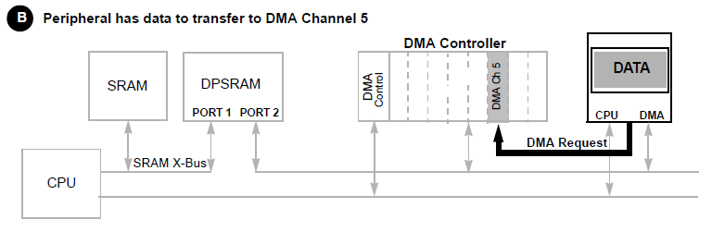
DMA EXAMPLE
When data is ready to be transferred from the peripheral, a DMA Request is issued by the peripheral.
The DMA request is arbitrated with any other coincident requests. If this channel has the highest priority, the transfer is completed during the next cycle.
Otherwise, the DMA request remains pending until it becomes the highest priority.
Notes:
DMA Request is usually the interrupt for that peripheral

Slide 25
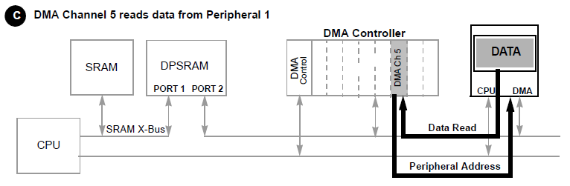
DMA EXAMPLE
The DMA Channel executes a data read from the designated peripheral address, which is user-application defined within the active channel.
Notes:
Describe address to read in DMAxPAD SFR. In the ADC case it is the buffer that the conversion is written to.

Slide 26
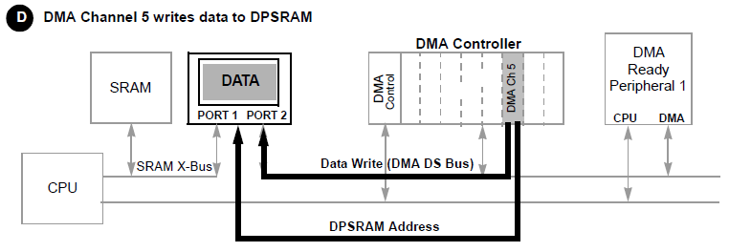
DMA EXAMPLE
The DMA Channel writes the data to the designated DPSRAM address.
Notes:
Where to write is programmed in DMAxSTA SFR. The DMA can keep track of an offset to add to this address, or the peripheral can provide the offset (AMODE = 10) this is called peripheral indirect addressing.

Slide 27
DMA Setup
DMA channels must be associated with peripherals (DMAxREQ, DMAxPAD)
Peripherals must be properly configured (Dependent on peripheral)
DPSRAM data start addresses must be initialized (DMAxSTA, DMAxSTB)
Initializing DMA transfer count (size of) must be initialized (DMAxCNT)
Appropriate addressing and operating modes must be selected(DMAxCON)

Slide 28
Operating Modes
Word or Byte data transfer
Transfer direction (peripheral to DPSRAM, or DPSRAM to peripheral)
Full or half transfer interrupts to CPU

Slide 29
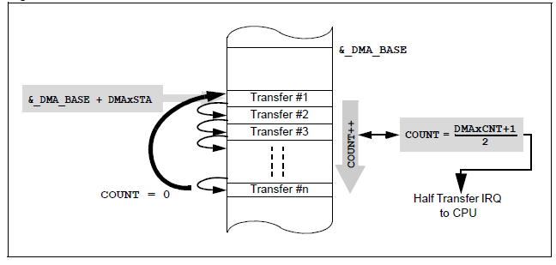
Full or Half
You can clear the half way interrupt in the ISR and then get another interrupt at full

Slide 30
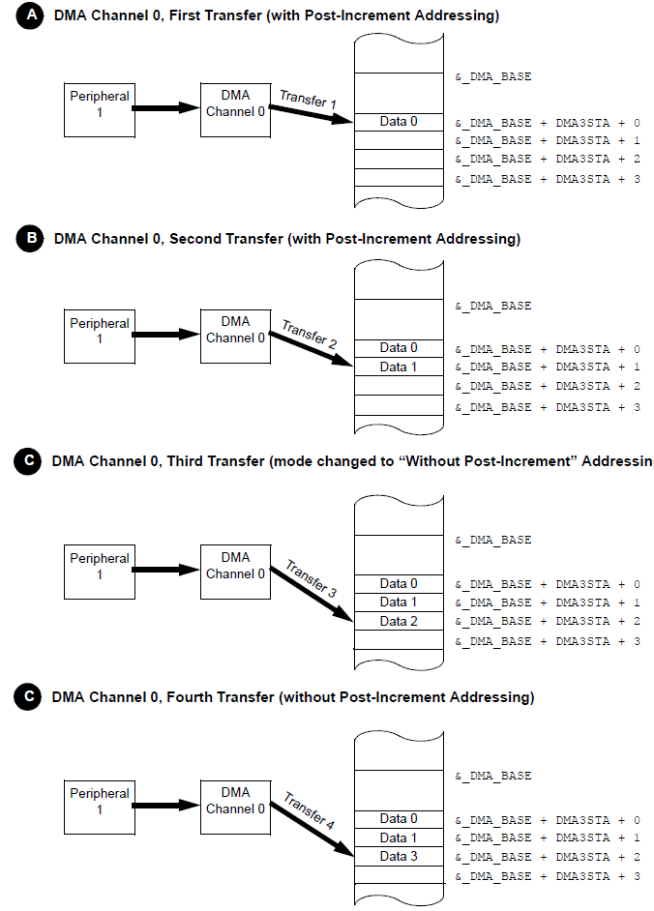
Operating Mode Register Indirect Post-Increment or static DPSRAM addressing

Slide 31
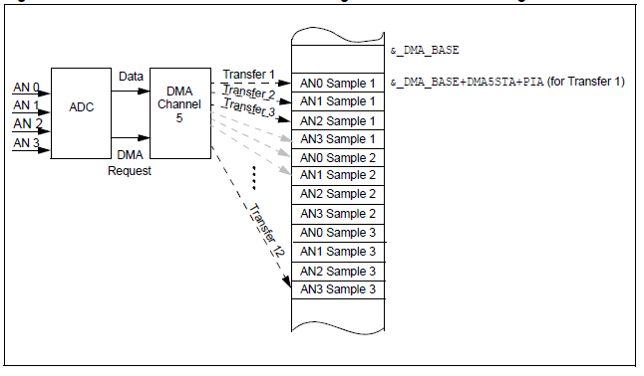
Operating Mode: Register Indirect Addressing
Addressing in to DPSRAM is controlled by the DMA controller

Slide 32
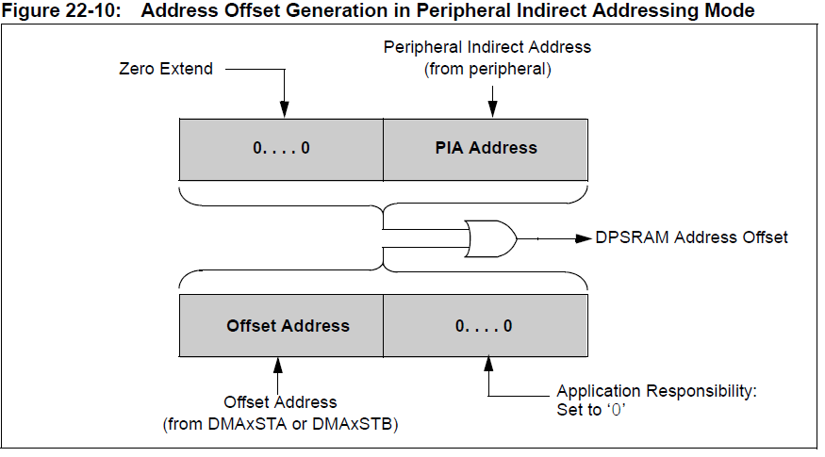
Address Generation in Peripheral Indirect Addressing

Slide 33
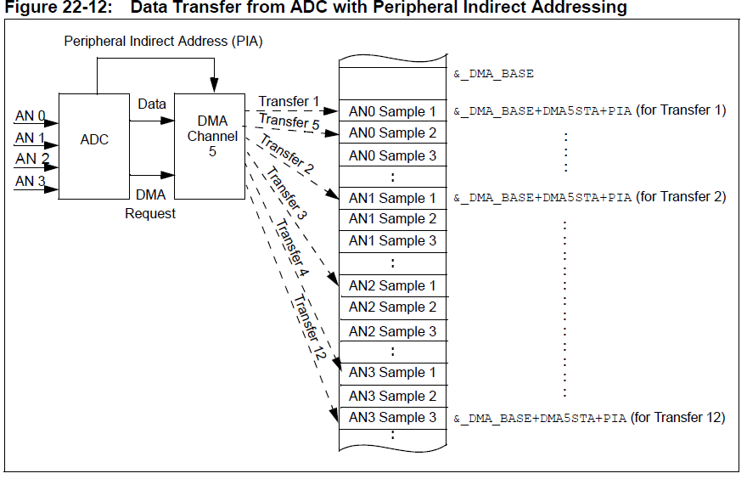
Operation Mode: Peripheral Indirect Addressing
Notes:
This is called scatter / gather mode in the ADC.

Slide 34
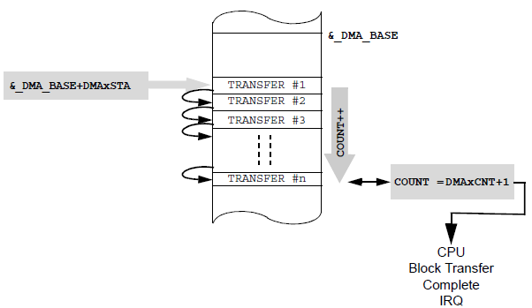
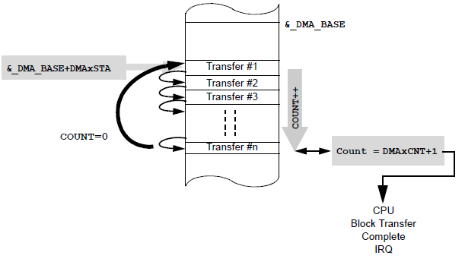
Operating Mode One-Shot or continuous block transfers
Notes:
If block mode you can restart a block by just enabling the DMA channel again. One shot when repetition is not needed.

Slide 35
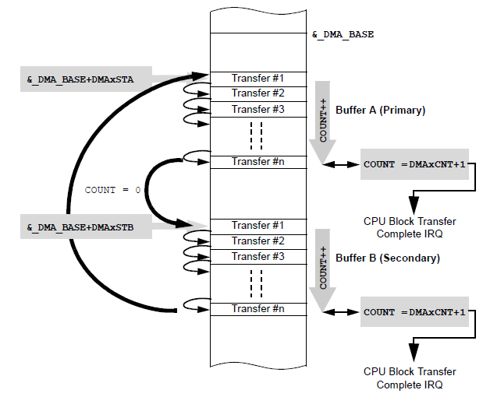
Operating Mode: Ping-Pong mode

Slide 36
OperatingMode
Manual – can force a DMA transaction
Null Write – useful in communication protocols

Slide 37
Review of ADC Application to Semester Project
The following are suggestions and not mandatory
The suggestions are implemented in the setup code given to you.

Slide 38
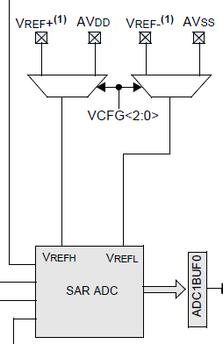
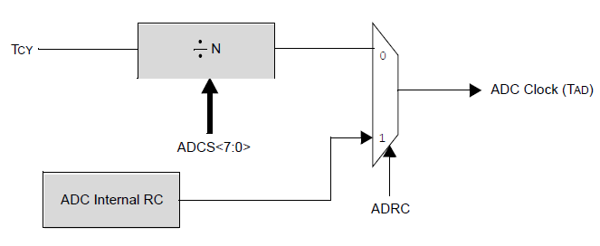
ADC Setup
_AD12B=0; //10 bit mode (bits defined only for ADC 1)
_ADRC = 0; //clock derived from system clock
_ADCS = 1; //Tad = 1/16e6*2 = 125 ns
_VCFG = 0b000; //voltage references are AVdd and Avss
_FORM =0; //unsigned integer format
Notes:
Possible that better accuracy could be obtained by slowing down the conversion clock. Trial and error would be effective to see if it gets better. Clock must be longer than 65 ns

Slide 39
Setup Port Pins to be used
_PCFG0 = 0; //Ensure that ANO is an analog input
_PCFG3 = 0; //Ensure that AN3 is an analog input
_TRISB0 = 1;// make sure they are configured as inputs
_TRISB3 = 1;

Slide 40
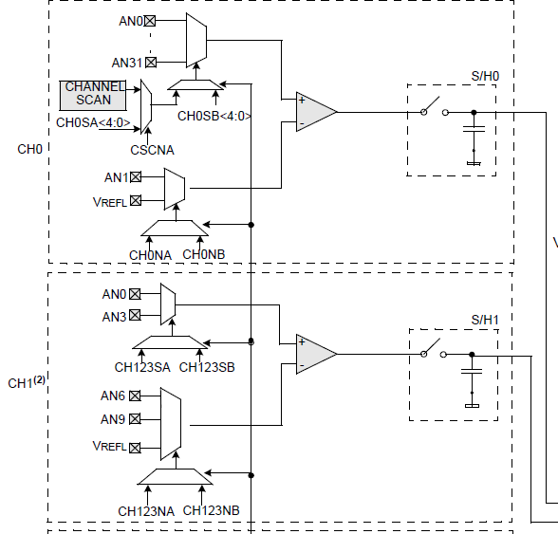
Select Port Pins
// AD1CHS0
_CH0NA = 0; // negative input is VREF- on channel 0
_CH0SA = 0; //positive input is connected to AN0
// AD1CHS
_CH123NA = 0; // negative input is VREF- on channel 1
_CH123SA = 1; // positive input for channel 1 is AN3

Slide 41
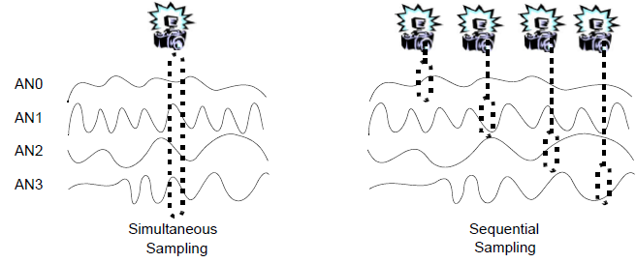
Sampling
_SIMSAM = 1; //simultaneous sampling
_ALTS = 0; //Always use channel input selects for Sample A
_CHPS = 0b01; // convert CHO and CH1
_SMPI = 0; //generate and interrupt for every conversion

Slide 42
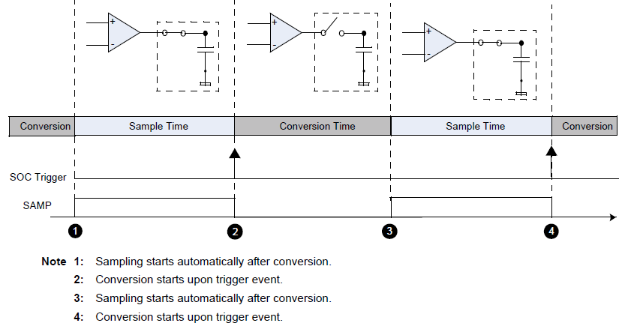
Sample Timing
_SSRC = 0b010;// Start conversion with timer 3
_ASAM = 1; //start sampling immediately after conversion
//set up timer 1 to trigger conversion
PR3=13333; //set up interrupt to occur 13,333*62.5ns = 833us TMR3=0;
T3CON = 0b1000000000000000;//internal clock 16 Mhz,prescale //1:1, 62.5 ns per tic, turn on
Notes:
Conversion time = Tad * 12 = 1.5 us
Sample time = 833us – 1.5 us = 831.5 us

Slide 43
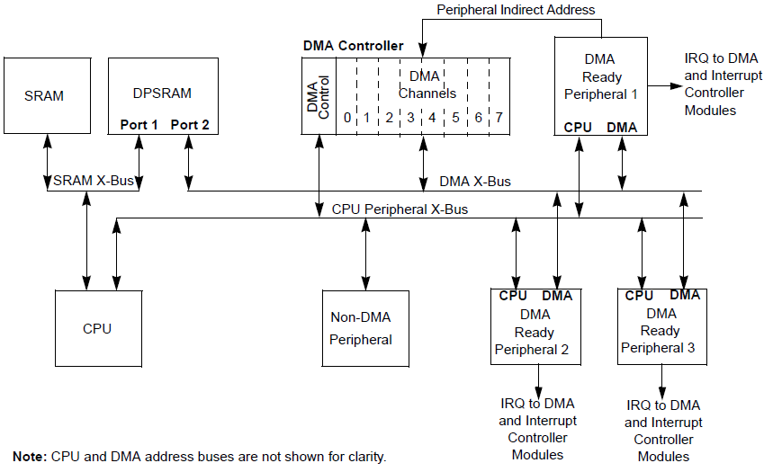
DMA SETUP
_SIZE = 0; //this sets a word size
_DIR = 0; //Read from ADC write to DMA
DMA0STA = BeginDMA;//This is the beginning of DMA
DMA0PAD = 0x300; //This is the location of ADC1BUF0
DMA0CNT = 239; //This is the size of the DMA buffer

Slide 44
DMA to ADC interface
_AMODE = 0; // DMA writes value and increments the address //register for the next write
_ADDMABM =1; //DMA channels are written in the order of //conversion
_DMABL = 0; // Must be set to 0 for Register indirect addressing
Notes:
_AMODE Register indirect addressing mode i.e. address does not come from ADC

Slide 45
DMA MODE
_HALF = 0; //DMA interrupt upon buffer bein full NOT half full
_NULLW = 0; //function turned off normal operation
_MODE = 0; // Continuous mode ping pong disabled.
_IRQSEL = 0b0001101; //ADC1 will interrupt DMA

Slide 46
Interrupt Setup and Turn On
_IPL = 0; //ensure that interrupt will occur
_DMA0IF = 0; //make sure DAM Channel 0 // interrupt flag is reset
_DMA0IE =1; //enable DMA interrupt
//turn on DMA Channel 0
_CHEN =1;
//turn on ADC1
_ADON=1;

